Slide 1
Limits, Continuity and Differentiability
Afifa Tabassum Chaity

Slide 2
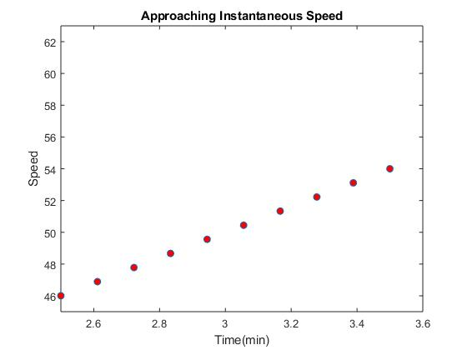
Limit

Slide 3


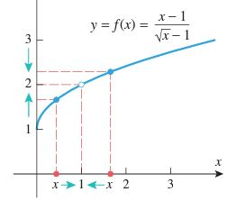
Limit

Slide 4
One sided limits
y
y
L
L
a
x
a
x
Left sided limit
Right sided limit

Slide 5
One sided limits

Slide 6
Existence of limit
y
y
1
x
-1
0
x
and
and
Limit doesn’t exist
Limit exists

Slide 7
Limits at infinity
y
y
Horizontal asymptote, y=L
y=f(x)
y=f(x)
Horizontal asymptote, y=L
x
x

Slide 8
Properties of limit
Let, a be a real number and
and
Then:

Slide 9
Applications of Limit
Studying the behavior of a function.
Checking the continuity of a function
Analysis of market behavior.
Analysis of response of body to various factors over time.
The maximum load a bridge can bear is determined by considering the limits of material strength and structural integrity.
Analysis of changes in ecosystems over time.

Slide 10
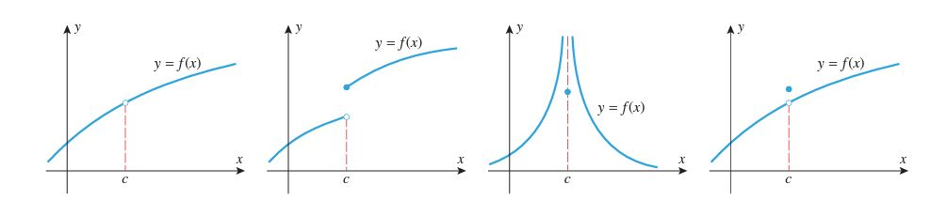
Continuity

Slide 11
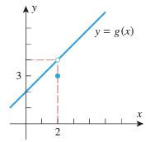


Applications of continuity
Determine if the function is continuous at x=2

Slide 12

Vertical Asymptote
$$\lim_{x→a}{f\left(x\right)=∞}$$

Slide 13

Horizontal Asymptote
$$\lim_{x→∞}{f\left(x\right)=L}$$

Slide 14



Differentiability
$$m_{sec}=\frac{f\left(x+a\right)−f(x)}{\left(x+a\right)−x}$$
$$m_{sec}=\lim_{a→x}{\frac{f\left(x+a\right)−f(x)}{\left(x+a\right)−x}}$$
$$m_{tan}=\lim_{h→0}{\frac{f\left(x+h\right)−f(x)}{h}}$$

Slide 15
Differentiability
A function f is called differentiable at a point if the limit
……….(1)
exists. (1) is called the derivative function of f(x).
If f is differentiable in , then f is differentiable everywhere.

Slide 16
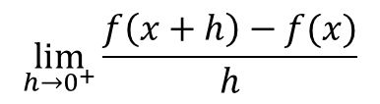

Left Hand Derivative Right Hand Derivative
$$\lim_{h→0^{−}}{\frac{f\left(x+h\right)−f(x)}{h}}$$
$$\lim_{h→0^{+}}{\frac{f\left(x+h\right)−f(x)}{h}}$$

Slide 17
A function f is not differentiable if in the graph of f there’s
Corner points
Points of vertical tangency exists.

Slide 19
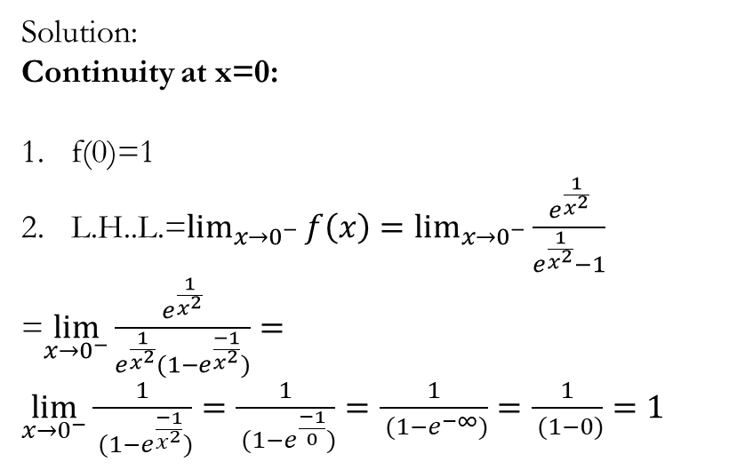
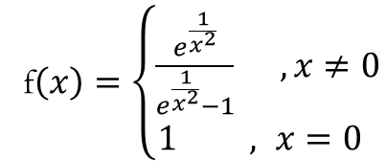
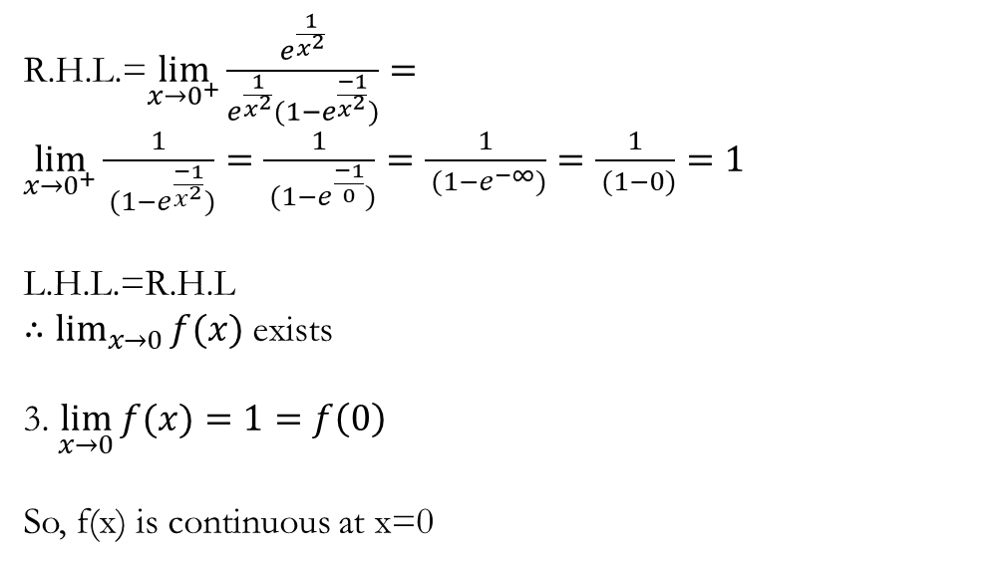
R.H.L.=$\lim_{x→0^{+}}{\frac{e^{\frac{1}{x^{2}}}}{e^{\frac{1}{x^{2}}}(1−e^{\frac{−1}{x^{2}}})}}=\lim_{x→0^{+}}{\frac{1}{ (1−e^{\frac{−1}{x^{2}}})}=\frac{1}{ (1−e^{\frac{−1}{0}})}=\frac{1}{ (1−e^{−∞})}=\frac{1}{ (1−0)}=1}$
L.H.L.=R.H.L
$∴\lim_{x→0}{f(x)}$ exists
3. $\lim_{x→0}{f(x)}=1=f\left(0\right)$
So, f(x) is continuous at x=0
1. Check the continuity and differentiability at x=0
f$\left(x\right)=\left\{\begin{aligned}\frac{e^{\frac{1}{x^{2}}}}{e^{\frac{1}{x^{2}}}−1} ,x≠0 \\ 1 , x=0 \end{aligned}\right.$
Solution:
Continuity at x=0:
f(0)=1
L.H..L.=$\lim_{x→0^{−}}{f\left(x\right)=\lim_{x→0^{−}}{\frac{e^{\frac{1}{x^{2}}}}{e^{\frac{1}{x^{2}}}−1}}}$
=$\lim_{x→0^{−}}{\frac{e^{\frac{1}{x^{2}}}}{e^{\frac{1}{x^{2}}}(1−e^{\frac{−1}{x^{2}}})}}=\lim_{x→0^{−}}{\frac{1}{ (1−e^{\frac{−1}{x^{2}}})}=\frac{1}{ (1−e^{\frac{−1}{0}})}=\frac{1}{ (1−e^{−∞})}=\frac{1}{ (1−0)}=1}$

Slide 20
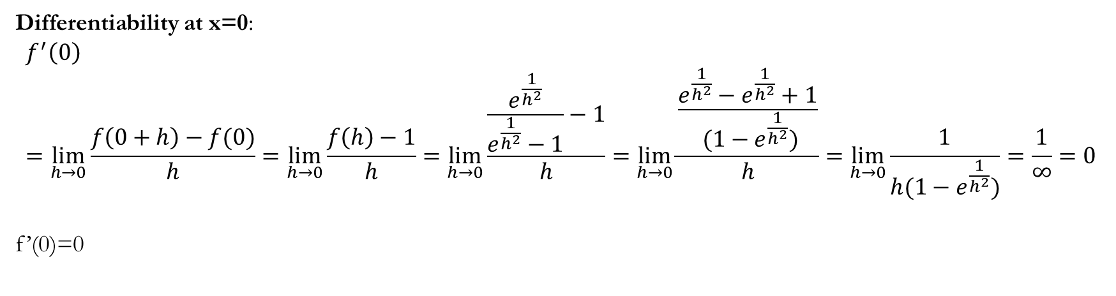
Differentiability at x=0:
$$f^{′}\left(0\right)=\lim_{h→0}{\frac{f\left(0+h\right)−f(0)}{h}=\lim_{h→0}{\frac{f\left(h\right)−1}{h}=\lim_{h→0}{\frac{\frac{e^{\frac{1}{h^{2}}}}{e^{\frac{1}{h^{2}}}−1}−1}{h}=\lim_{h→0}{\frac{\frac{e^{\frac{1}{h^{2}}}−e^{\frac{1}{h^{2}}}+1}{ (1−e^{\frac{1}{h^{2}}})}}{h}=\lim_{h→0}{\frac{1}{h(1−e^{\frac{1}{h^{2}}})}=\frac{1}{∞}=0}}}}}$$
f’(0)=0

Slide 21
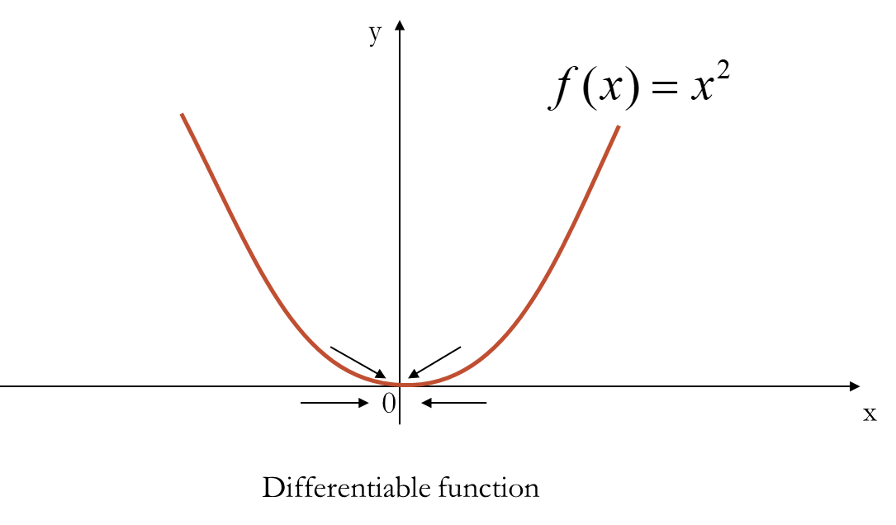

Slide 22
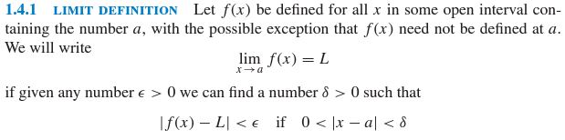
Appendix
Applications of differentiation
Rate of change of function with time (velocity, acceleration)
Finding the maximum or minimum of a function, and identify critical points where the derivative is zero
Measuring population growth, radioactive decay, and the spread of diseases.

Slide 23
Reference
Calculus-Early Transcendentals, Howard Anton, 10th edition, 2017, pages 67-150
https://phys23p.sl.psu.edu/~mrg3/mathanim/calc_I/1_sided_limit_matched.htmlhttps://phys23p.sl.psu.edu/~mrg3/mathanim/calc_I/1_sided_limit_matched.html

